Slide 2
DataStax Enterprise 6 Solution Day

Slide 3



Your speakers today
Negib Marhoul
Solution Architect
negib.marhoul@datastax.com
Twitter : @nmarhoul
Github : https://github.com/norim
Cedrick Lunven
Developer Advocate
cedrick.lunven@datastax.com
Twitter : @clunven
Github : https://github.com/clun

Slide 4
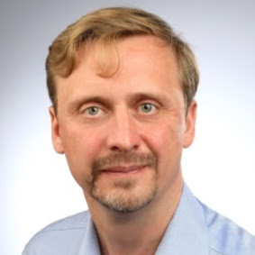
Your speakers today
Alexey Ott
Solution Architect
alexey.ott@datastax.com
Twitter : @alexott_en
Github : https://github.com/alexott

Slide 5
Agenda

Slide 6
Agenda

Slide 7
Housekeeping
You should have these things:
Laptop (preferably with SSH client)
Internet Connection
Optional : Docker installed
Have questions?
https://github.com/DataStax-Academy/solution-day-2018

Slide 8
DataStax Solution Day Takeaway
Take DataStax home with you
Be the first on your team using DSE 6!
Head to the Operations Solution Zone
We’ll help you get DataStax Enterprise installed as a Docker image on your laptop
DSE Server
DSE OpsCenter
DSE Studio

Slide 9
Agenda

Slide 10
DataStax Enterprise Overview
Notes:
Now I’d like to show you Cassandra in action and what that experience is like, working with CQL in DataStax Enterprise

Slide 11
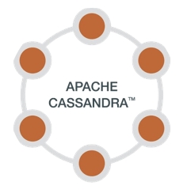


Apache Cassandra
Distributed
Apache Cassandra ® Apache Software Foundation
Notes:
We built DSE to address these cloud application characteristics
They help describe why we were major contributors behind Apache Cassandra, and other open source technologies
And it’s why this technology has been applied successfully in many companies
Cassandra was first developed at Facebook (explain other details)
DataStax Enterprise is our distribution of Apache Cassandra.
We say this distribution is the best because of the additional security and performance features we put into the core database and the testing and hardening we do

Slide 12





Distributed
Applications must be able to be distributed across data centers and cloud regions
AWS
Azure
San Francisco
On Prem
Users accessing a cloud region or data center from laptop, mobile device, etc.
Munich
On Prem
Notes:
When our applications are successful, we see their scope expanding worldwide,
We begin to deploy them across multiple data centers so we can do a better job of servicing our users wherever they are
These data centers might be on premises, in various public clouds, or both

Slide 13

Hybrid and Multi-Cloud is a strategic imperative
Distributed
“Hybrid Cloud offers the best of both worlds.”
NO 27%
YES 73%
Notes:
This is an important point.
Companies have a significant investment in on-premise technology,
but they’re also are taking advantage of public cloud services to be able to scale rapidly and reduce time-to-market for new services.
A more recent trend is the usage of multiple public clouds, which we refer to as multi-cloud.

Slide 14

Apache Cassandra
Distributed
AlwaysOn
Apache Cassandra ® Apache Software Foundation
Notes:
We built DSE to address these cloud application characteristics
They help describe why we were major contributors behind Apache Cassandra, and other open source technologies
And it’s why this technology has been applied successfully in many companies
Cassandra was first developed at Facebook (explain other details)
DataStax Enterprise is our distribution of Apache Cassandra.
We say this distribution is the best because of the additional security and performance features we put into the core database and the testing and hardening we do

Slide 15
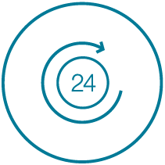
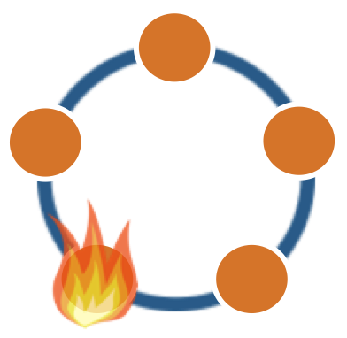
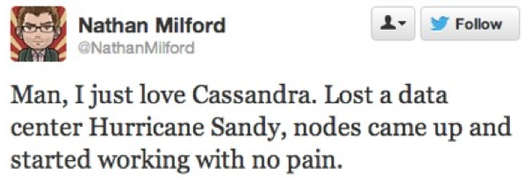
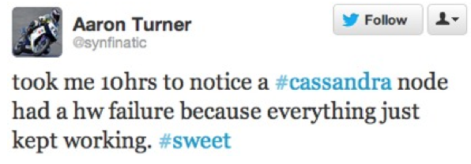
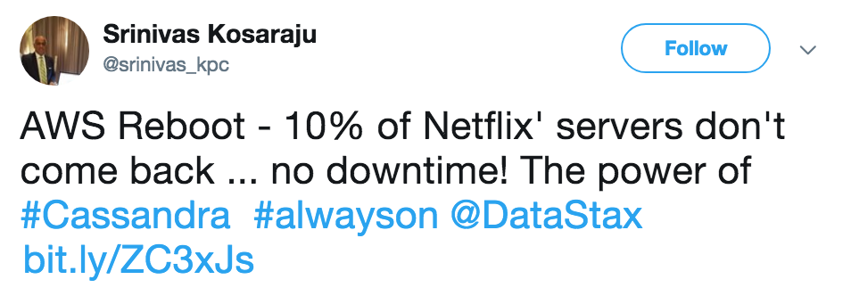

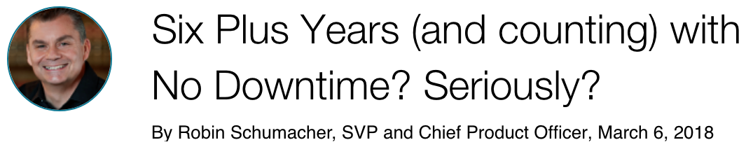
Always-On
Nodes down = still available!
Data center down = still available!
Upgrade = zero downtime!
Notes:
Second, we expect these applications to be always-on, always available, never down
Being always-on requires underlying technology that can survive the loss of a portion of its capability and keep rolling, as you see in some of these tweets and articles below

Slide 16

Apache Cassandra
Distributed
AlwaysOn
Scalable
Apache Cassandra ® Apache Software Foundation
Notes:
We built DSE to address these cloud application characteristics
They help describe why we were major contributors behind Apache Cassandra, and other open source technologies
And it’s why this technology has been applied successfully in many companies
Cassandra was first developed at Facebook (explain other details)
DataStax Enterprise is our distribution of Apache Cassandra.
We say this distribution is the best because of the additional security and performance features we put into the core database and the testing and hardening we do

Slide 17

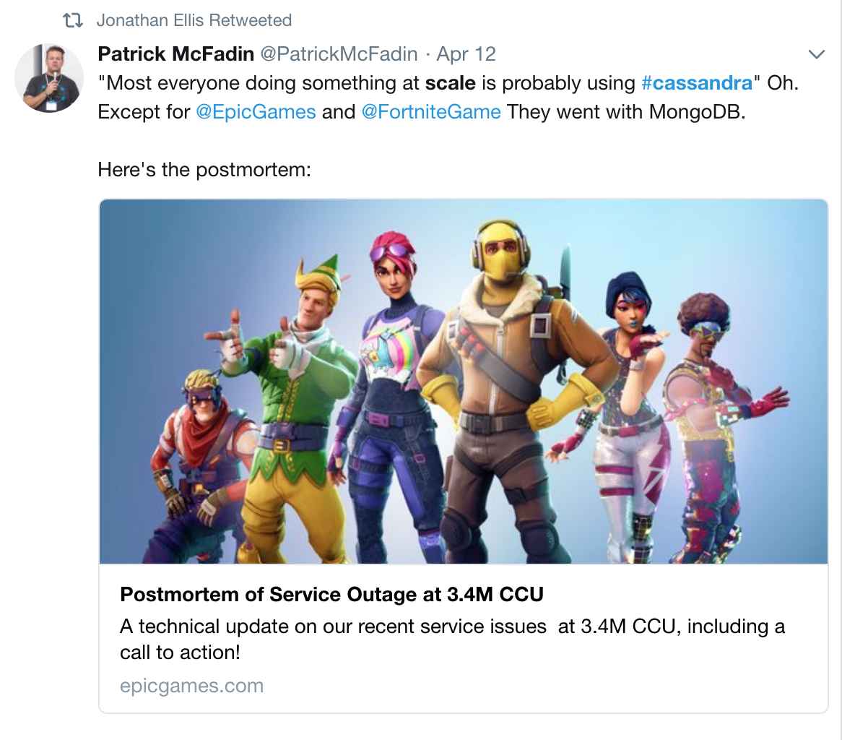
Scalable
Applications need to scale linearly and predictably to support user and feature growth.
Additional Hardware (scale up and/or out)
Users / Workloads
Notes:
Finally, cloud applications must be scalable.
We’re looking to build systems that scales linearly with the number of users
Patrick had a fun Tweet recently that highlighted the importance of choosing data layer technology
Your choices tend to get exposed when you have a sudden surge in popularity or demand on your system, like Fortnite’s recent outage

Slide 18

Apache Cassandra
Distributed
Real Time
AlwaysOn
Scalable
Apache Cassandra ® Apache Software Foundation
Notes:
We built DSE to address these cloud application characteristics
They help describe why we were major contributors behind Apache Cassandra, and other open source technologies
And it’s why this technology has been applied successfully in many companies
Cassandra was first developed at Facebook (explain other details)
DataStax Enterprise is our distribution of Apache Cassandra.
We say this distribution is the best because of the additional security and performance features we put into the core database and the testing and hardening we do

Slide 19

Real-time
Customers expect great responsiveness from the applications they use, and if they don’t operate at real-time speeds, the effect on the user is similar to the application being unavailable.
’1% decrease in sales for every 100 milliseconds of page load.’
Amazon.com
Notes:
We need our apps to respond to us in real-time, no matter where we are.
We get impatient when we experience slow responses and timeouts and our attention tends to drift elsewhere

Slide 20
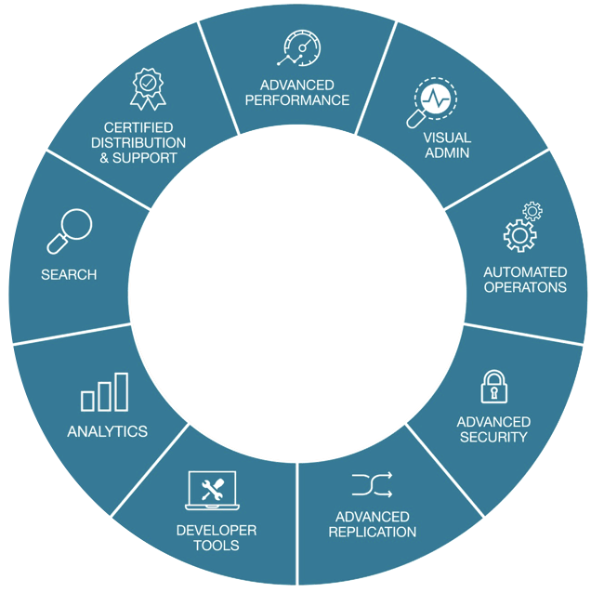
DataStax Enterprise
Notes:
We built DSE to address these cloud application characteristics
They help describe why we were major contributors behind Apache Cassandra, and other open source technologies
And it’s why this technology has been applied successfully in many companies
Cassandra was first developed at Facebook (explain other details)
DataStax Enterprise is our distribution of Apache Cassandra.
We say this distribution is the best because of the additional security and performance features we put into the core database and the testing and hardening we do

Slide 21

Expert Support
Support available 24x7, 365 days per year
Covers licensed production and non-production environments
Ticket priority drives SLA
Global workflow available for urgent production issues
Certified service packs that keep your software up-to-date
Hot-fix support for emergency situations
Premium Support available for an additional cost
Support Engineers average 15+ years of experience

Slide 22


Professional Services
Architecture Review
Customer Success Architect
Dev & Ops Primer
Production Readiness
Sprint Advisory
Search, Analytics, & Graph Primers
Implementation blueprints
Architecture and design
Implementation services
Assessment and health checks
Customer success architect
Enterprise adoption framework
Peak season support
Technical Project Management

Slide 23

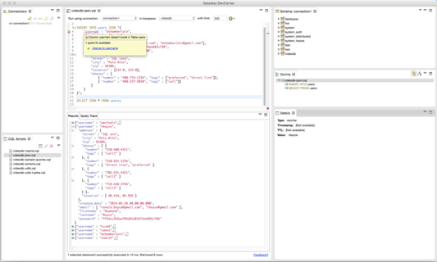
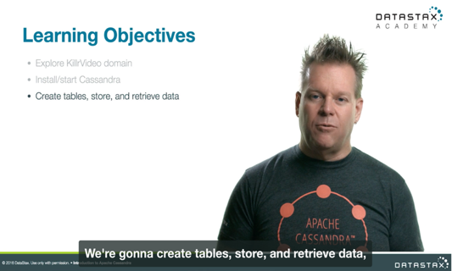
Get trained up and certified
DataStax Academy
Free online
In-person or private
Certifications
Virtual instructor led training
DataStax Slack channel
http://academy.datastax.com

Slide 24
DataStax Enterprise
Notes:
We built DSE to address these cloud application characteristics
They help describe why we were major contributors behind Apache Cassandra, and other open source technologies
And it’s why this technology has been applied successfully in many companies
Cassandra was first developed at Facebook (explain other details)
DataStax Enterprise is our distribution of Apache Cassandra.
We say this distribution is the best because of the additional security and performance features we put into the core database and the testing and hardening we do

Slide 25




Advanced Security
External Authentication
External validation of authorized users
Leverages Kerberos & LDAP/AD
Single sign-on to all data domains
Transparent Data Encryption
Protects sensitive data at rest via encryption
No changes needed at app level
Data Auditing
Audit trail of all accesses and changes
Control to audit only what’s needed
Uses log4j interface to ensure performance & efficient audit
Notes:
DSE provides built-in enterprise security and authentication features to ensure customers’ sensitive information is always protected and stringent compliance requirements are always met. DSE provides support for industry standard authentication mechanisms, role-based authentication, user activity auditing, and end-to-end encryption. The role-based access controls allow you to easily provision and manage the permissions of users across a variety of sources including LDAP, Active Directory and Kerberos. DSE allows you to utilize multiple sources of authentication and role assignments in the same cluster, e.g. Active Directory for administrators, and Kerberos for applications.

Slide 26
DataStax Enterprise
Notes:
We built DSE to address these cloud application characteristics
They help describe why we were major contributors behind Apache Cassandra, and other open source technologies
And it’s why this technology has been applied successfully in many companies
Cassandra was first developed at Facebook (explain other details)
DataStax Enterprise is our distribution of Apache Cassandra.
We say this distribution is the best because of the additional security and performance features we put into the core database and the testing and hardening we do

Slide 27
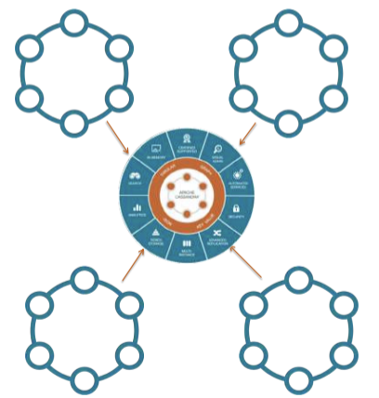
Des Advanced Replication
Allows one-way replication from “edge” cluster to another
Centralized hub cluster.
Ideal for retail, energy, and other “edge of the internet of things” use cases.

Slide 28
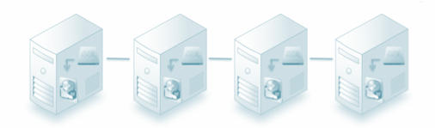
Tiered Storage
Move old data to cheaper drives
Reduced storage cost
Data is always online
Automatic, done in background
Notes:
DSE allows database administrators to leverage multiple storage options in order to achieve performance and cost optimizations goals. The tiered storage option in DSE intelligently moves older and less frequently accessed data to cheaper tiers of conventional storage such as HDD, such data migration happens transparently without any human intervention.

Slide 29
DataStax Enterprise
Notes:
We built DSE to address these cloud application characteristics
They help describe why we were major contributors behind Apache Cassandra, and other open source technologies
And it’s why this technology has been applied successfully in many companies
Cassandra was first developed at Facebook (explain other details)
DataStax Enterprise is our distribution of Apache Cassandra.
We say this distribution is the best because of the additional security and performance features we put into the core database and the testing and hardening we do

Slide 30
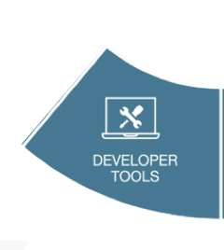
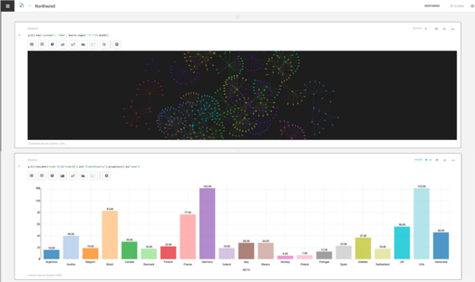
DataStax Studio
Visual development tool for DSE
Explore and query CQL, Gremlin Query Language, and SparkSQL
Auto-completion, data and result set visualization, execution management, and much more
Built-in collaboration & history management
Notes:
DSE Studio is a browser-based, interactive application development solution allowing you to manage database schema, develop query, tune the application performance, and troubleshoot DSE. It provides an intuitive interface for developers and analysts to collaborate and test theories by mixing code, documentation, query results and visualizations into self-documenting notebooks.

Slide 31
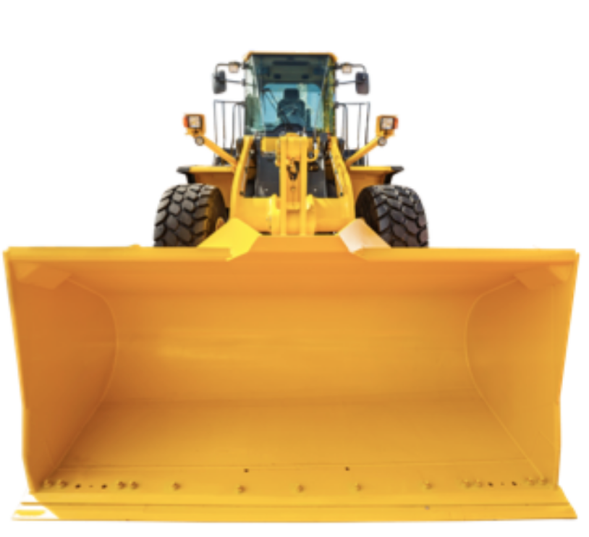
DataStax Bulk Loader
Move data in and out of DSE
Simplifies data loading and unloading
Supports CSV and JSON formats
Command-line interface
Up to 4x faster than community utilities.

Slide 32
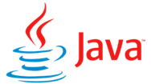

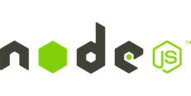
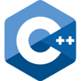

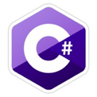


DataStax Drivers
DataStax Cassandra Drivers (OSS)
CQL Support
Sync / Async API
Address Translation
Load Balancing Policies
Retry Policies
Reconnection Policies
DataStax Enterprise Drivers
OSS Drivers capabilities plus Enterprise improvements for
Performance, Usability, Scalability, Ecosystem
DSE Advanced Security, Unified Authentication
DSE Graph Fluent API
DSE Geometric Types
Connection Pooling
Auto Node Discovery
SSL
Compression
Query Builder
Object Mapper
ODBC
JDBC

Slide 33
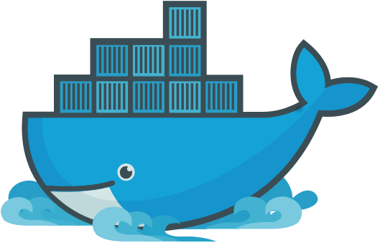
DataStax Enterprise Docker Images
DataStax Docker Images for Non-Production available on Docker Hub
DSE Server
OpsCenter
Studio
https://hub.docker.com/u/datastax/
docker run -e "DS_LICENSE=accept" -it -d -p 9042:9042 --name dse6 datastax/dse-server
docker run -e "DS_LICENSE=accept" -it -d -p 9091:9091 --link dse6:dse6 datastax/dse-studio

Slide 34
DataStax Enterprise
Notes:
We built DSE to address these cloud application characteristics
They help describe why we were major contributors behind Apache Cassandra, and other open source technologies
And it’s why this technology has been applied successfully in many companies
Cassandra was first developed at Facebook (explain other details)
DataStax Enterprise is our distribution of Apache Cassandra.
We say this distribution is the best because of the additional security and performance features we put into the core database and the testing and hardening we do

Slide 35

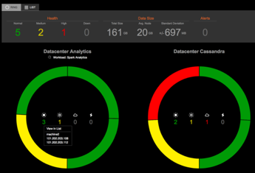

DSE OpsCenter
Control automatic management services including transparent repair
Manage and schedule backup and restore operations
Perform capacity planning with historical trend analysis and forecasting capabilities
Proactively manage all clusters with threshold and timing-based alerts
Visually create new clusters or upgrade existing clusters with a few mouse clicks either on premise or in the cloud
Integrate with the enterprise landscape.
Built-in Automatic Failover
Visual management tool for DSE
"... OpsCenter allows us to act on things before they become a problem."
Notes:
DataStax OpsCenter is the browser-based visual management and monitoring solution for DataStax Enterprise. OpsCenter and the integrated management services provide data center administrator with the capabilities to intelligently and proactively manage multiple database clusters and simplify everyday tasks. At the click of a button you can provision, monitor, backup and manage your DSE clusters.

Slide 36
DataStax Enterprise
Notes:
We built DSE to address these cloud application characteristics
They help describe why we were major contributors behind Apache Cassandra, and other open source technologies
And it’s why this technology has been applied successfully in many companies
Cassandra was first developed at Facebook (explain other details)
DataStax Enterprise is our distribution of Apache Cassandra.
We say this distribution is the best because of the additional security and performance features we put into the core database and the testing and hardening we do

Slide 37


Dse Search
Your Application
Live indexing engine with powerful search
Automatic indexing on insert
Higher ingestion throughput
Distributed query optimization
Compared to self-managed:
No separate search cluster to manage
Probably less total hardware required
No “Split Brain” data inconsistencies
No ETL or synch to build and maintain
No app level data management code
CQL
Search
+
Cassandra
Notes:
We are really excited about these performance improvements because of what they mean for you – with twice the read/write throughput, you can run the same workloads on less hardware
It’s not just about performance, we’re also making major gains in operational simplicity and developer productivity
We’re making it easier for operators to run DSE with features like NodeSync
We’re making it easier for developers to create applications and interact with data through improvements in our drivers and DataStax Studio

Slide 38
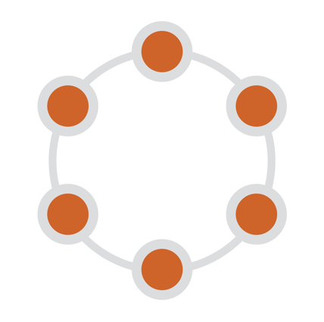
DSE Search
Supports ad-hoc queries not supported by Cassandra
Full text search, Faceting, Suggester
Geospatial Search
Live indexing engine
Automatic indexing on insert
Higher ingestion throughput
Distributed query optimization
Compared to self-managed:
No separate search cluster to manage
No ETL or synch to build and maintain
Search indexes co-located with Cassandra
Search-enabled Data Center
Notes:
So DSE Search enables us to perform queries that aren’t supported in regular CQL
In DSE search we’ve extended CQL to make search enabled CQL, which allows us to do ad-hoc queries on columns that aren’t part of our primary key
We can do full text and geospatial searches
In DSE we use technologies like Solr and Lucene to maintain search indexes on each node
This saves you from having to setup/maintain a separate search cluster
Integrated within each node of DSE is an advanced indexing engine with powerful search capabilities based on Solr. The indexing engine allows you to easily find data in real-time using complex queries and includes support for sub-string, fuzzy and full text search. The indexing engine also has full support for real-time aggregations, faceting, and filtering, making it easy to locate data relevant to your applications. When user updates a table via CQL API, the Solr document is updated and re-indexing occurs automatically after the update. The integration of indexing and search makes it simple to target use cases that require indexing transactions, hosting product catalogs, or searching document repositories, it also eliminate complex tasks such as ETL, Sync or application-level data management.

Slide 39


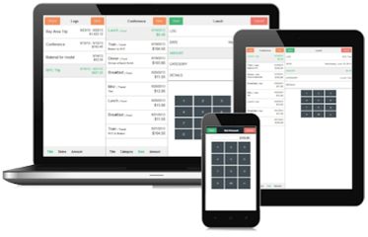
Dse Analytics
Single DSE Custer
Your Application
Cassandra
Streaming, ad-hoc, and batch
High-performance
High availability
Workload management
SQL reporting
Compared to self-managed:
No ETL
True HA without Zookeeper
Real Time Replication
Your Analytics
Analytics
Notes:
We are really excited about these performance improvements because of what they mean for you – with twice the read/write throughput, you can run the same workloads on less hardware
It’s not just about performance, we’re also making major gains in operational simplicity and developer productivity
We’re making it easier for operators to run DSE with features like NodeSync
We’re making it easier for developers to create applications and interact with data through improvements in our drivers and DataStax Studio

Slide 40
DSE Analytics: Spark + Cassandra
Read/write Cassandra data from Spark via DataStax Connector
Co-located Spark with Cassandra
Spark SQL
Spark Streaming
MLib
GraphX
Spark Core Engine
DataStax Spark-Cassandra Connector
Analytics Data Center
Cassandra
Notes:
Analytics supports a similar kind of architecture to our search integration.
We run spark workers co located with our Cassandra nodes
The Spark Cassandra connector enables us to distribute Spark jobs so that work is performed as close to the data as possible
Making this a highly scalable solution

Slide 41
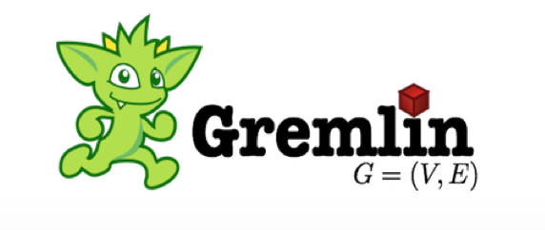

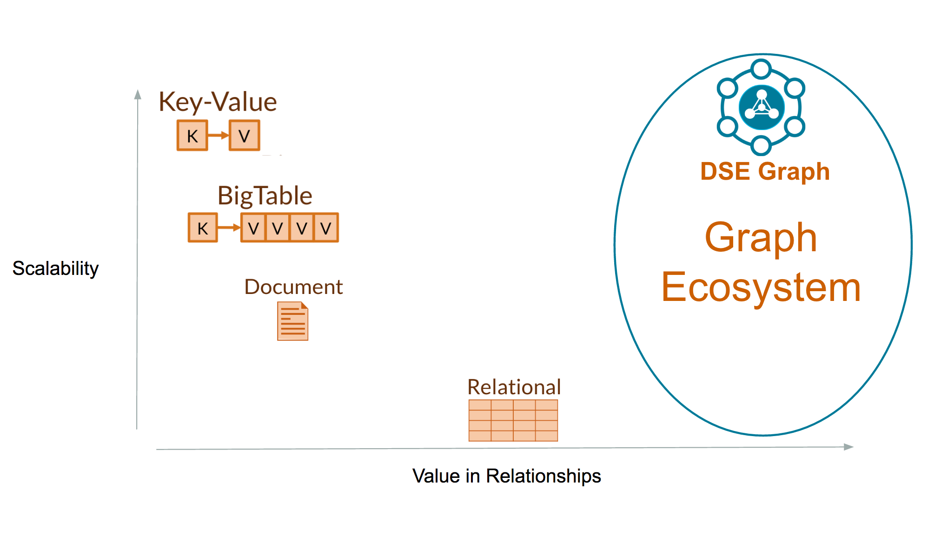
Dse Graph
A scalable, distributed graph database optimized for storing, traversing, and querying complex graph data in real- time
Value data between relationships
DSE Analytics and Search integrated
Perfect for use cases:
Customer 360
Recommendations
Fraud Detection
Notes:
We are really excited about these performance improvements because of what they mean for you – with twice the read/write throughput, you can run the same workloads on less hardware
It’s not just about performance, we’re also making major gains in operational simplicity and developer productivity
We’re making it easier for operators to run DSE with features like NodeSync
We’re making it easier for developers to create applications and interact with data through improvements in our drivers and DataStax Studio

Slide 42
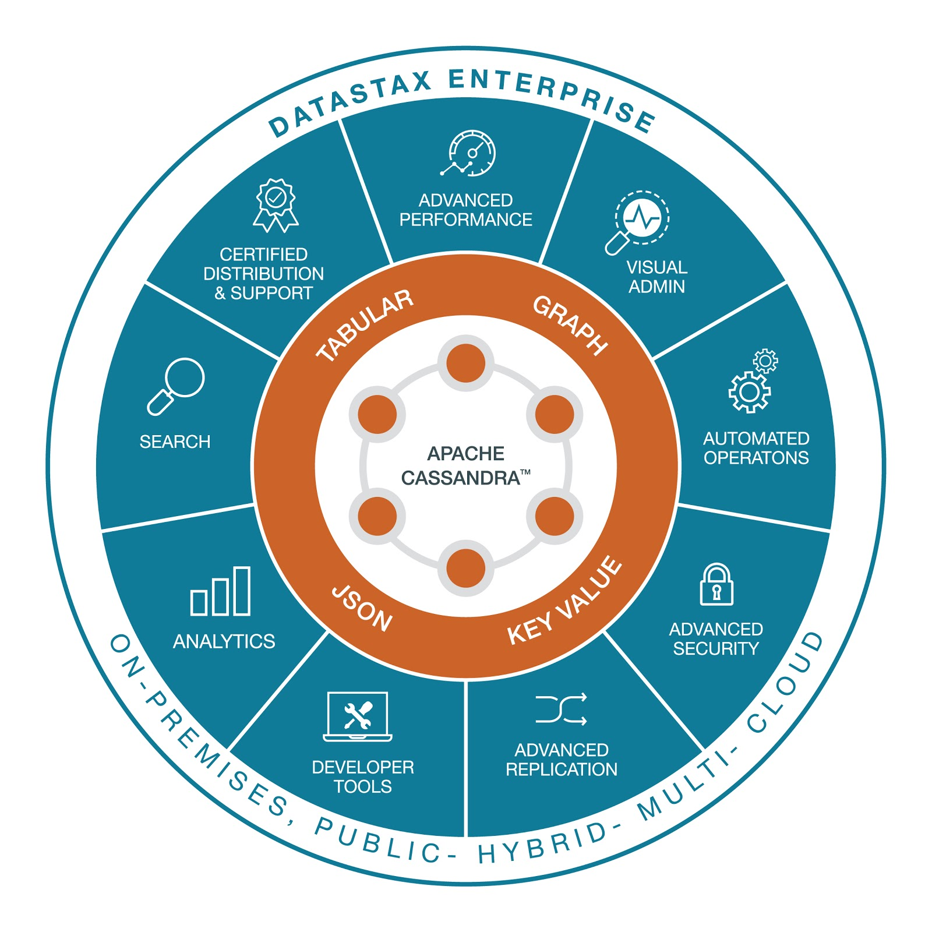
OSS Foundations, Integrated for the Enterprise
Apache Cassandra, Spark, Lucene, Solr, TinkerPop ® Apache Software Foundation
Notes:
Let’s dive a bit deeper into the components of DataStax Enterprise
As you may know, the core of DSE is our distribution of Apache Cassandra.
We also integrate other open source technologies throughout the product
For example, we leverage Solr, a distributed search technology, and Lucene, a highly performant search engine with Cassandra for our DSE Search feature
We integrate with Apache Spark to support realtime analytics using data stored in Cassandra and other data sources
Most recently, we’ve taken work from Titan DB and the Apache TinkerPop product to produce a highly scalable graph database on top of Cassandra
We have a history of contributions to open source projects that continue, but we are also adding features that differentiate from the open source.

Slide 43

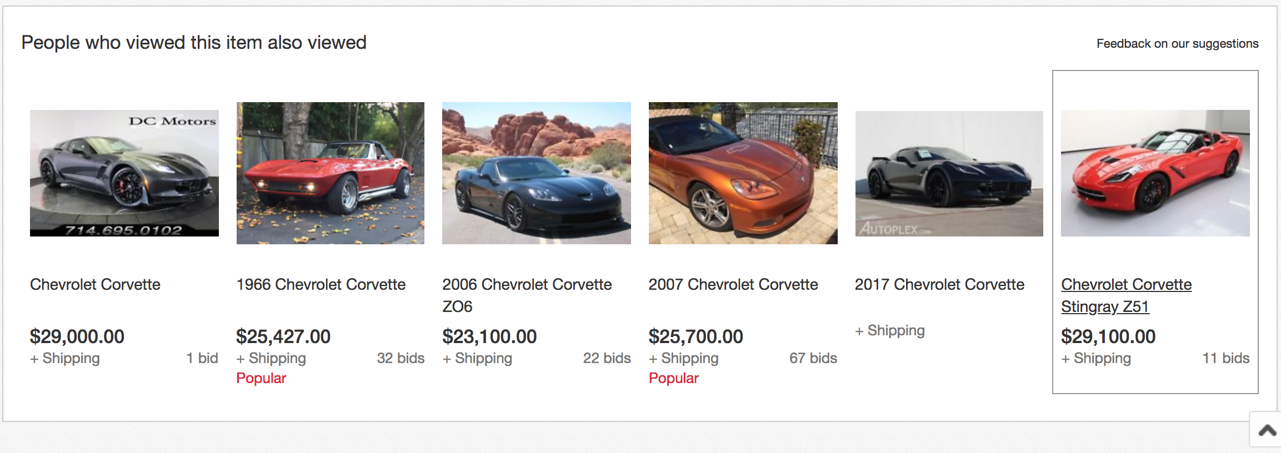

Contextual
Serve relevant and holistic information.
Search, analytics and, graph are critical capabilities to serve personalized experiences, recommendations, and fraud detection.
Notes:
Let’s explore these attributes, first contextual.
Apps today have to be contextual and personalized for individual users like us.
They need to understand something about who we are and what we’re trying to do
Being contextual requires understanding of relationships and patterns amongst various types of data

Slide 44





Cloud Application Characteristics
CONTEXTUAL
ALWAYS-ON
REAL-TIME
DISTRIBUTED
SCALABLE
Notes:
To answer this, we need to take a look at the characteristics of cloud-scale applications
We’ve identified these 5 attributes as being key: cloud applications must be contextual, always-on, real-time, distributed, and scalable

Slide 45
What’s new with DSE 6
Notes:
Now I’d like to show you Cassandra in action and what that experience is like, working with CQL in DataStax Enterprise

Slide 46
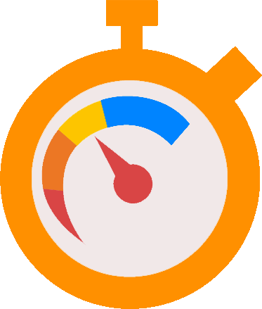
> 2X Writes
Advanced Performance
~ 2X Reads
This is a ‘once every seven years’ rewrite.
JONATHAN ELLIS
Notes:
To cite a few of these, we’re seeing 2 times faster reads and writes vs. open source Cassandra.
We’ve made significant modifications to the core engine under the hood to achieve this – see JE quote

Slide 47
3X Query
DSE Spark Connectivity
Notes:
We’re seeing 3x performance improvements on analytic queries with Spark in DSE Analytics

Slide 48
~ 4X Load
DataStax Bulk Loader
> 4X Unload
Please give me a faster and easier way to load data.
DATASTAX CUSTOMER
Notes:
We’ve also made it way faster to get data in and out of DSE with our new bulk loader.
We’re seeing 4 times faster load and unload times vs. existing community tools

Slide 49
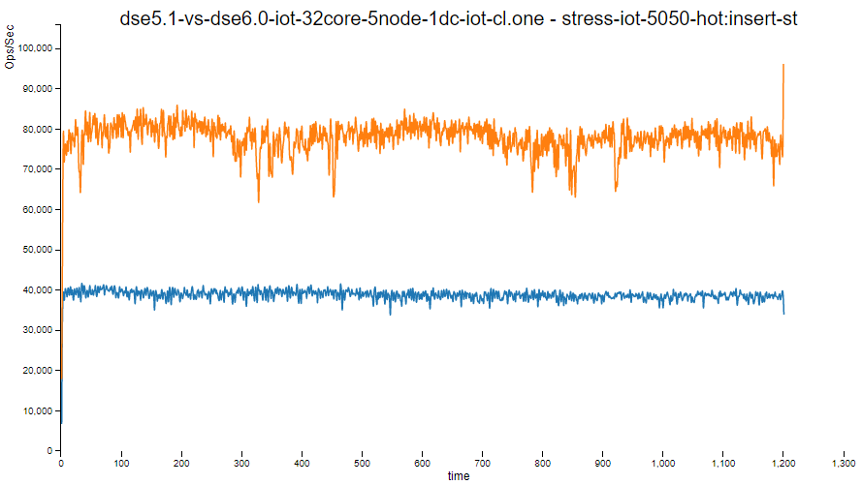
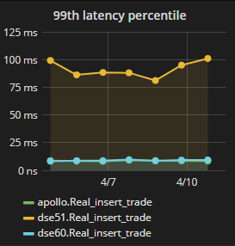
2x Increased Throughput, Decreased Latency

Slide 50
What’s in DataStax Enterprise 6?
Double the performance
Less hardware required for your workload
Improved p99 read/write latency
Self-driving operational simplicity
Public / Private / Hybrid clouds
Reduced repairs with NodeSync
Robust transactional analytics
Support for Spark SQL in DataStax Studio
AlwaysOn SQL
Streaming from Apache Kafka, file systems, other sources
Notes:
We are really excited about these performance improvements because of what they mean for you – with twice the read/write throughput, you can run the same workloads on less hardware
It’s not just about performance, we’re also making major gains in operational simplicity and developer productivity
We’re making it easier for operators to run DSE with features like NodeSync
We’re making it easier for developers to create applications and interact with data through improvements in our drivers and DataStax Studio

Slide 51





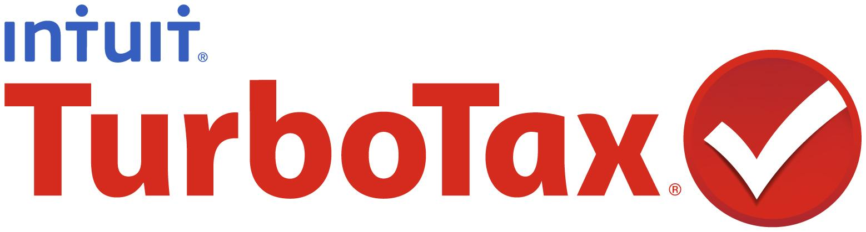










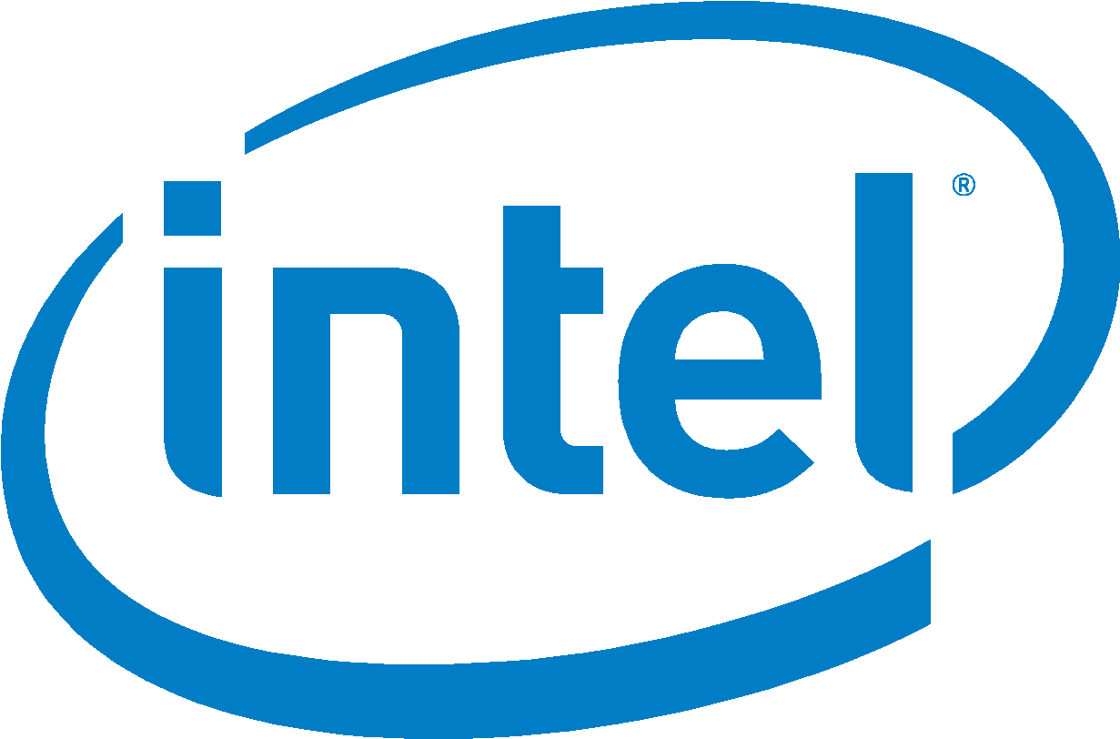









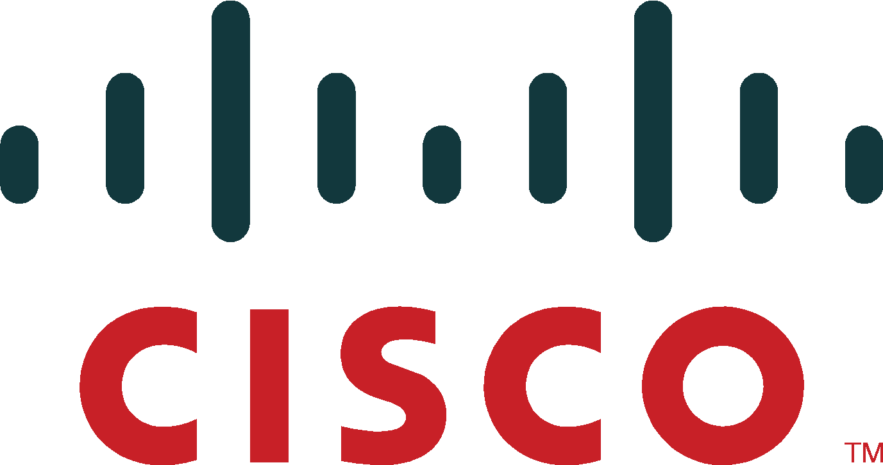




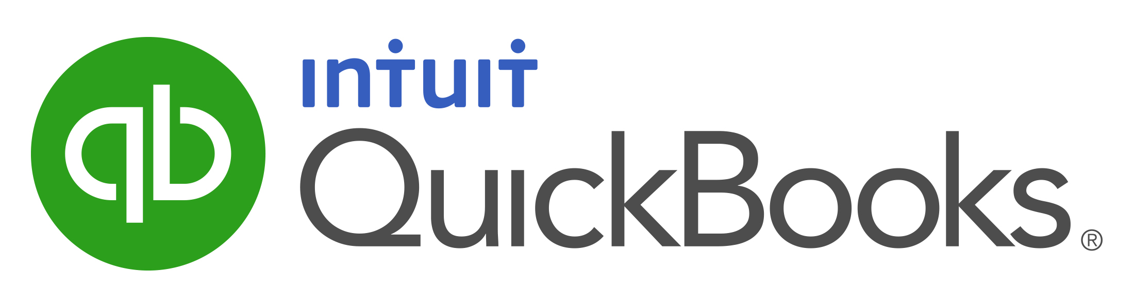





DataStax Use Cases
MDM: Customer 360, Product Catalog
Personalization and Recommendation
Internet of Things (IoT) and Time Series
Fraud Detection
List Management
Messaging
Inventory Management
Authentication

Slide 52
Thank you

